Slide 1

Geometry
Unit 6, Lesson H2 Proofs by Contradiction Volume 1, pg. 321

Slide 2


Benchmark
MA.912.LT.4.8
Construct proofs, including proofs by contradiction.
volume 1, pg. 321

Slide 3
Integrated Mathematical Thinking and Reasoning Standards
MA.K12.MTR.1.1 Actively participate in effortful learning both individually and collectively.
MA.K12.MTR.3.1 Complete tasks with mathematical fluency.
MA.K12.MTR.4.1 Engage in discussions that reflect on the mathematical thinking of self and others.
MA.K12.MTR.6.1 Assess the reasonableness of solutions.
MA.K12.MTR.7.1 Apply mathematics to real-world contexts.
volume 1, pg. 321

Slide 4

Learning Target
I can use proof by contradiction to justify that all circles are similar.
volume 1, pg. 321

Slide 5

Warm-Up
volume 1, pg. 322

Slide 6

6.H2.1 Warm-Up: Critical Thinking
DirecTV commercials are entertaining because the conditional statements are outrageous. Write five conditional statements with an outrageous conclusion that could be used for a DirecTV commercial.
volume 1, pg. 322

Slide 7

Exploration
volume 1, pg. 322

Slide 8

6.H2.2 Exploration: Contradictions
In the DirecTV commercial, there were seven conditional statements before the final conclusion.
Order | Statement
1 | If your cable company puts you on hold, then you get angry.
2 | If you get angry, then you go blow off steam.
3 | If you go blow off steam, then an accident happens.
4 | If an accident happens, then you get an eye patch from the doctor.
volume 1, pg. 322

Slide 9
5 | If you get an eye patch, then people think you are tough.
6 | If people think you are tough, then they want to fight you.
7 | If people want to fight you, then you get hurt.
8 | You will end up in a roadside ditch.
volume 1, pg. 322

Slide 10
Assume that the conclusion is not true. Write a contradiction to the conclusion.
Share your contradiction with your partner.
volume 1, pg. 322

Slide 11
Use your contradiction to write a “rewind” for the commercial with statements that would lead to the contradiction.
Explain how writing the contradiction would change the commercial.
Order | Statement
8
7
6
5
4
3
2
1
volume 1, pg. 323

Slide 12
Exploration
volume 1, pg. 323

Slide 13
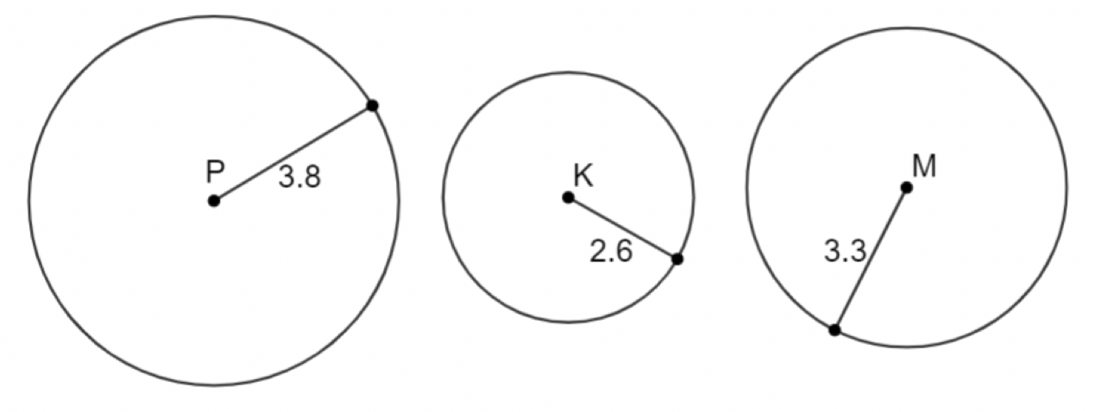
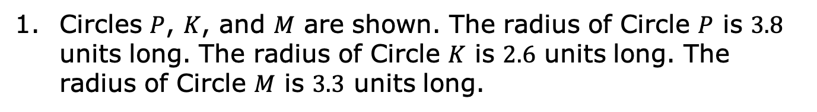
6.H2.3 Exploration: Circles Are Similar
Circles $P$, $K$, and $M$ are shown. The radius of Circle $P$ is $3.8$ units long. The radius of Circle $K$ is $2.6$ units long. The radius of Circle $M$ is $3.3$ units long.
volume 1, pg. 323

Slide 14
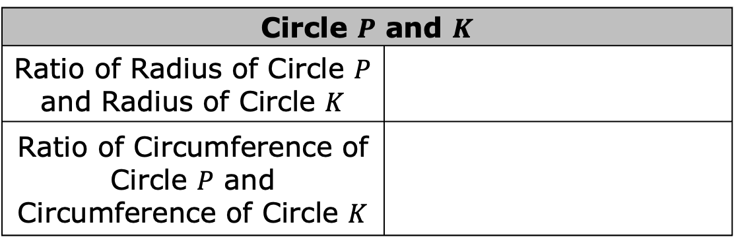
With your partner, fill in the table. Round to nearest thousandth. Use the pi button on your calculator.
Complete the table.
Circle | Radius | Circumference
Circle $P$ and $K$
Ratio of Radius of Circle $P$ and Radius of Circle $K$
Ratio of Circumference of Circle $P$ and Circumference of Circle $K$
volume 1, pg. 323

Slide 15
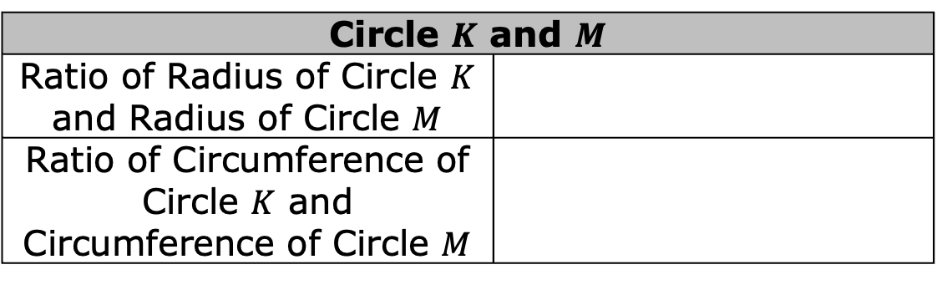
What do you notice about the ratios?
Complete the table.
What do you notice about the ratios?
Make a conjecture about the ratios of radii and circumferences of circles.
Circle $K$ and $M$
Ratio of Radius of Circle $K$ and Radius of Circle $M$
Ratio of Circumference of Circle $K$ and Circumference of Circle $M$
volume 1, pg. 324

Slide 16

Guided Instruction
volume 1, pg. 324

Slide 17


6.H2.4 Guided Instruction: Proof by Contradiction
A way to write a proof is by using a contradiction.
Proof by Contradiction
Assume the statement to be proven is false, and work to show its falsity until the result of that assumption is a contradiction.
volume 1, pg. 324

Slide 18
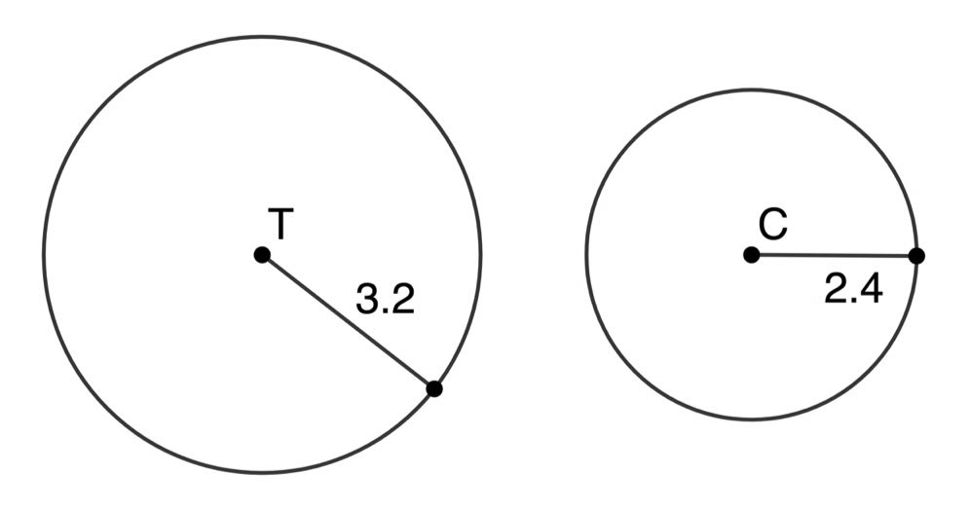

Circles $T$ and $C$ are shown. The radius of Circle $T$ is $3.2$ units long. The radius of Circle $C$ is $2.4$ units long.
Prove that Circle $T$ is similar to Circle $C$.
Write an assumption that the statement is false.
Find the ratio of the radius of Circle $T$ to the radius of Circle $C$.
volume 1, pg. 324

Slide 19
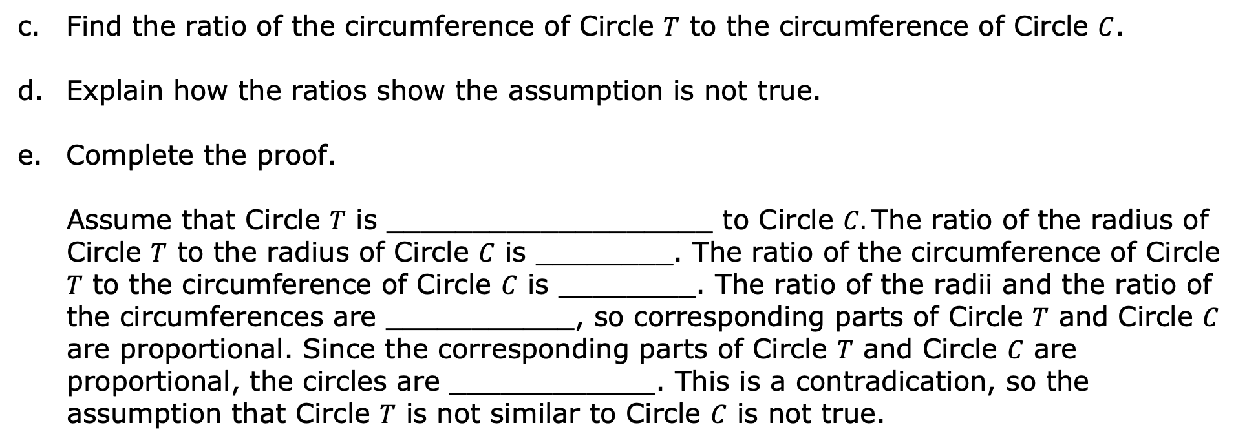
Find the ratio of the circumference of Circle $T$ to the circumference of Circle $C$.
Explain how the ratios show the assumption is not true.
Complete the proof.
Assume that Circle $T$ is ___________________ to Circle $C.$The ratio of the radius of Circle $T$ to the radius of Circle $C$ is ________. The ratio of the circumference of Circle $T$ to the circumference of Circle $C$ is ________. The ratio of the radii and the ratio of the circumferences are ___________, so corresponding parts of Circle $T$ and Circle $C$ are proportional. Since the corresponding parts of Circle $T$ and Circle $C$ are proportional, the circles are ____________. This is a contradication, so the assumption that Circle $T$ is not similar to Circle $C$ is not true.
volume 1, pg. 325

Slide 20

Wrap-Up
volume 1, pg. 325

Slide 21
6.H2.5 Wrap-Up: Reflection
Check below all the statements that apply to your understanding.
I understand how to write a contradiction.
I need support on how to write a contradiction.
I understand that all circles are similar.
I need support on understanding why all circles are similar.
I understand how to prove that all circles are similar by contradiction.
I need support on how to prove that all circles are similar by contradiction.
volume 1, pg. 325

